Slide 1
SQL Project
Movies
Analysis
by ,
Sowmya K

Slide 2
Agenda
Select and Where
Operators
Case Statement
Union
Group by , Order by, Having
Aggregate Function
Joins
With Clause
Window Functions

Slide 3
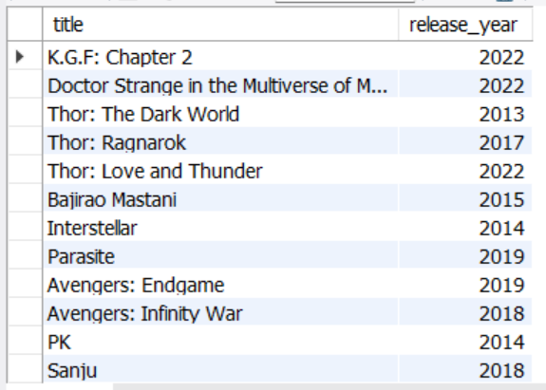
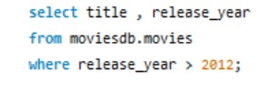
1.Select and Where : Write a query to select the titles of all movies released after the year 2012.

Slide 4
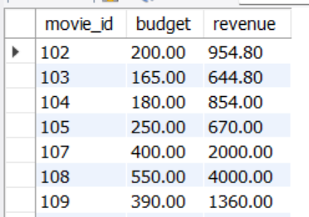
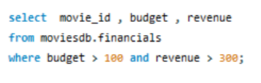
2. Operators: Write a query to find all movies with budget greater than 300 million and a box office revenue greater than 300 million.

Slide 5
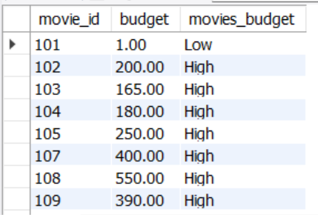
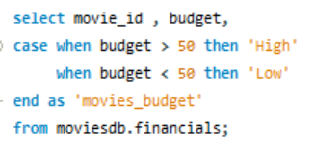
3. Case Statement: Write a query to list all movies with column indicating if the movie’s budget was ‘High’ (more than 50 million) or ‘Low’ (less than 50 million).

Slide 6
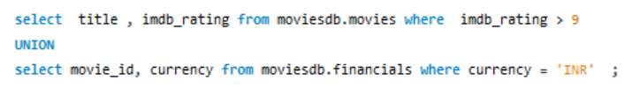
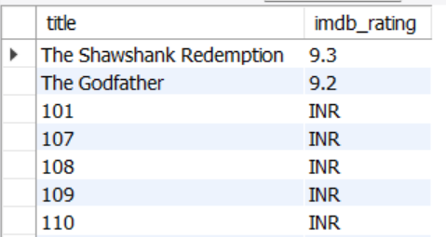
4. Union: Write a query to fetch the details like title, imdb-rating, movie-id, currency from movies and financials tables with imdb-rating > 9 and currency = ‘INR’.

Slide 7
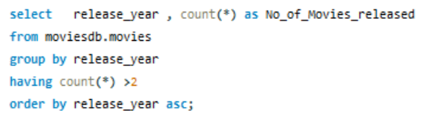
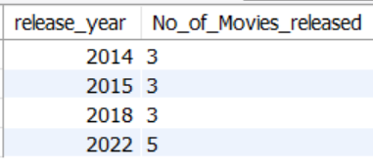
5. Group by , Order by , Having: Write a query to fetch release-year and total no of movies released in each year.

Slide 8


6. Aggregate Function : Write a query to find average budget of all movies.

Slide 9
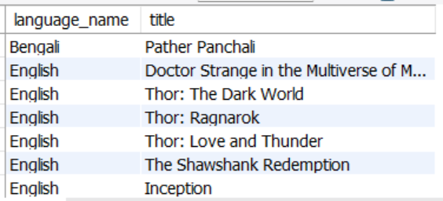
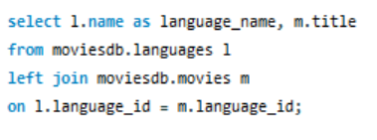
7. i) Left Joins: Write a query to fetch movie title with language name.

Slide 10
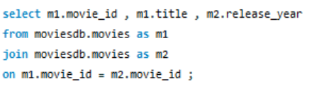
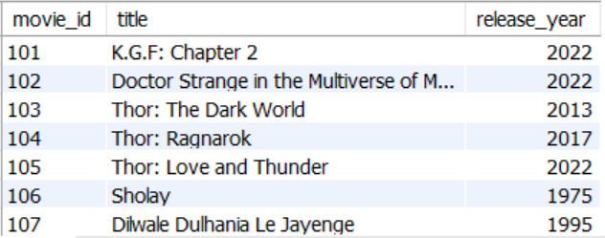
7 . ii) Self Join: Write a query to fetch movie-id, title and release-year from movies table.

Slide 11
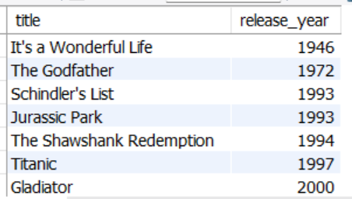
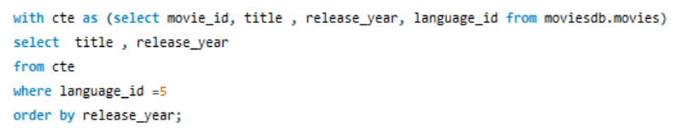
8. With clause: Query to fetch title , release-year using with clause.

Slide 12
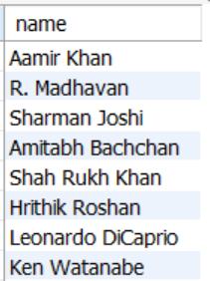
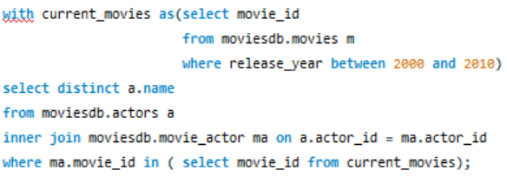
9. With clause using Joins: Write a query to display different Actor’s name who’s movie released in-between 2000 and 2010.

Slide 13
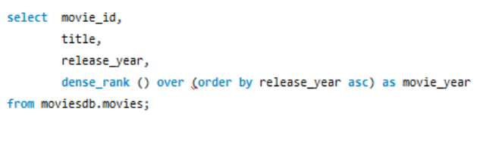
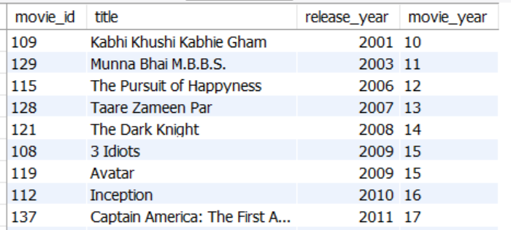
10. Window Function: Write a query to fetch movie-id, title, release-year by using dense-rank().

